Slide 1
Chiba Campaign 2019 11.23 Report
DAIYAJIE

Slide 2
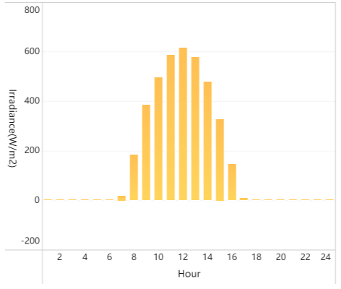
2019/11/21 solar radiation Hourly average

Slide 3
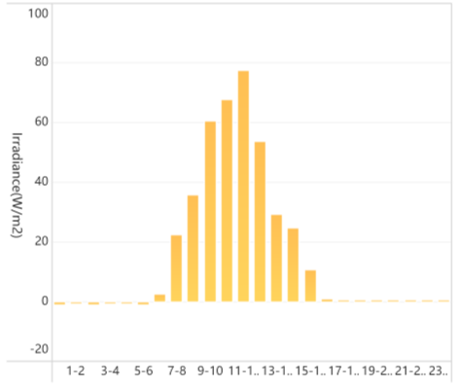
2019/11/22 solar radiation Hourly average

Slide 4
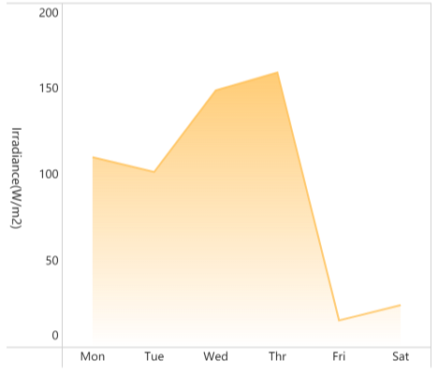
18-23 solar radiation Day average

